Slide 1
Lab 12
Assignment 2

Slide 2
Employee and Manager (10 points)
Read files SalaryLevel.java, Employee.java, and Manager.java in the assignment project, then add the missing code so that 1) the tests in EmployeeTest.java and ManagerTest.java will all pass and 2) the classes meet all the requirements specified in the Java files.

Slide 3
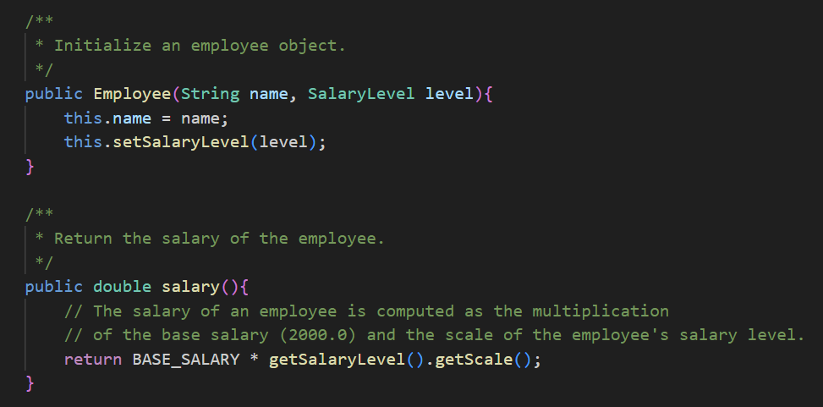
Employee Solution

Slide 4
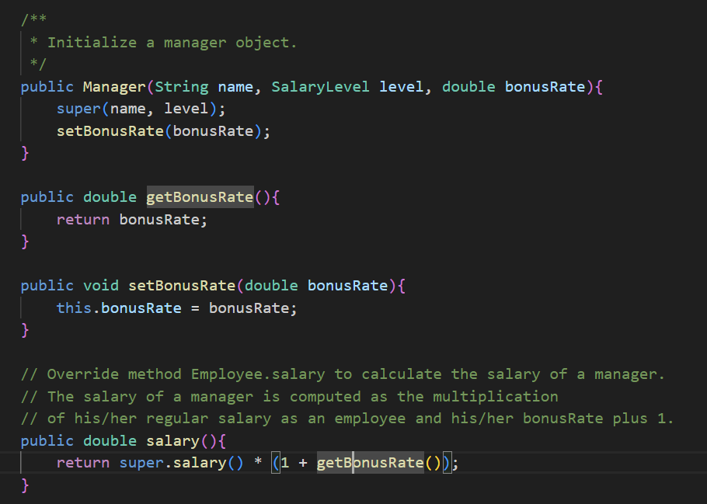
Manager Solution

Slide 5
2. Polymorphism and Dynamic Binding (12 points)
For each of the code fragment below,
1) indicate whether it compiles, and
2) explain why the code fragment does not compile, if that’s the case, or
3) specify the output of the code fragment, if it compiles and is executed.

Slide 6
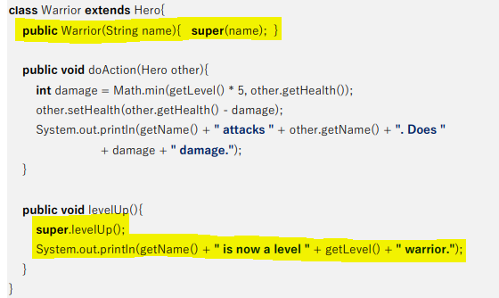
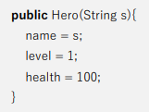

Task2 Solution
Code:
warrior = new Warrior("Thor");
warrior.levelUp();
Result:
Yes.
Thor is now a level 2
warrior.

Slide 7
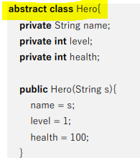
Task3 Solution
Code:
hero = new Hero("Althea"); hero.levelUp();
Result:
No.
Hero is abstract. Cannot create instances from an abstract class.

Slide 8
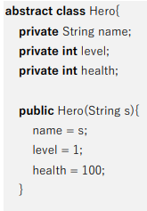
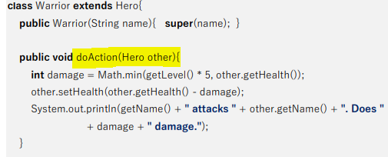
Task4 Solution
Code:
warrior = new Warrior("Thor");
healer = new Healer("Althea");
warrior.doAction(healer);
Result:
Yes.
Thor attacks Althea. Does 5 damage.

Slide 9
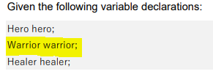
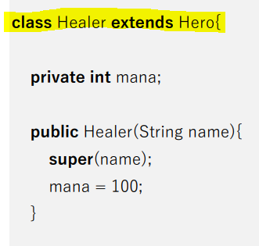
Task5 Solution
Code:
warrior = new Healer("Diana");
warrior.levelUp();
Result:
No.
Healer is not a subtype of Warrior.

Slide 10
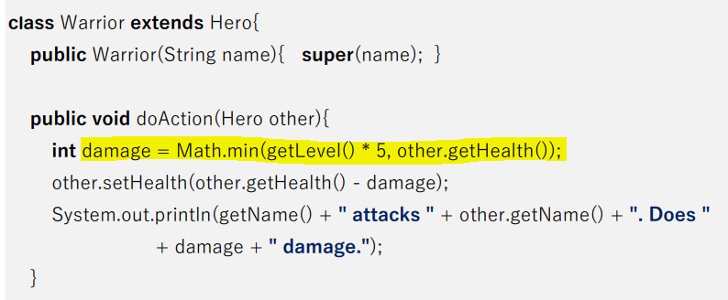

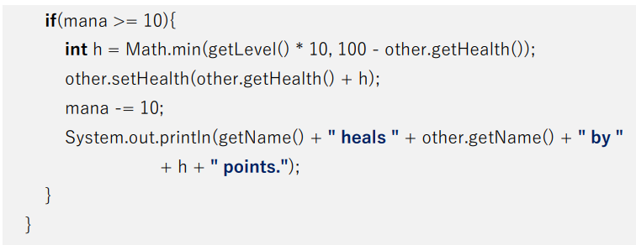
Task6 Solution
Code:
hero = new Warrior("Thor");
hero.doAction(hero);
hero = new Healer("Althea");
hero.doAction(hero);
Result:
Yes.
Thor attacks Thor. Does 5 damage.
Althea heals Althea by 0 points.

Slide 11
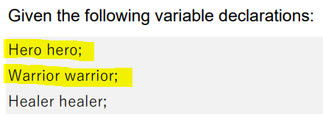
Task7 Solution
Code:
hero = new Warrior("Thor");
warrior = hero;
warrior.doAction(hero);
Result:
No.
Type narrowing is not always safe. Needs explicit type casting.
warrior = (Warrior) hero;

Slide 12
3. Generic Set (20 points)
Read and complete the class so that all requirements expressed in both CompSetTest.java and the code comments are satisfied. Note that you are not allowed to add new fields to class CompSet.

Slide 13
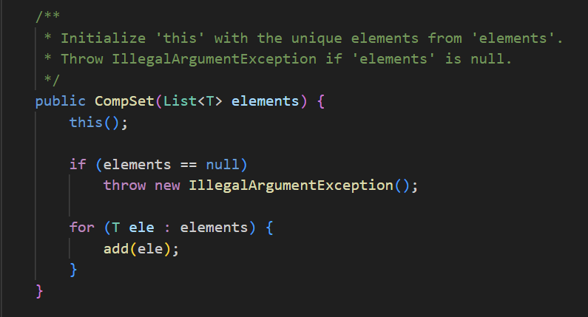

Slide 14
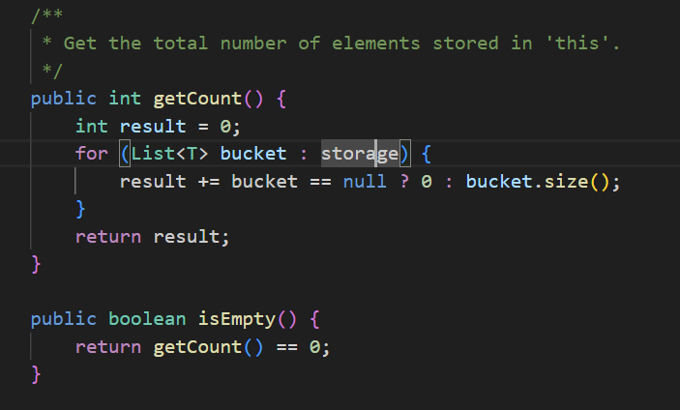

Slide 15
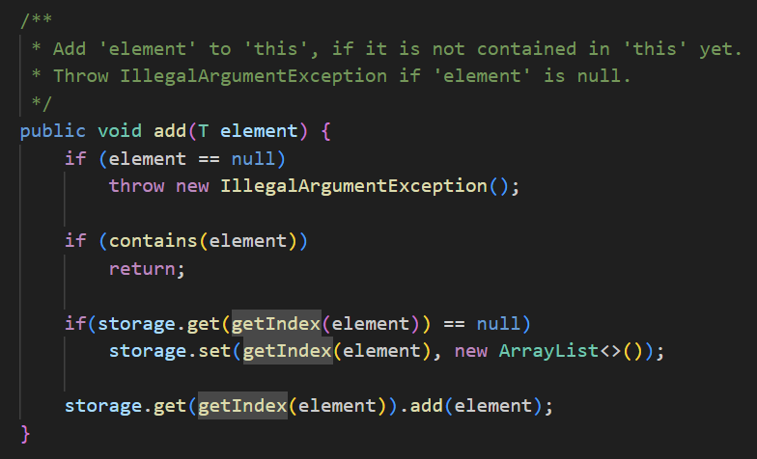

Slide 16
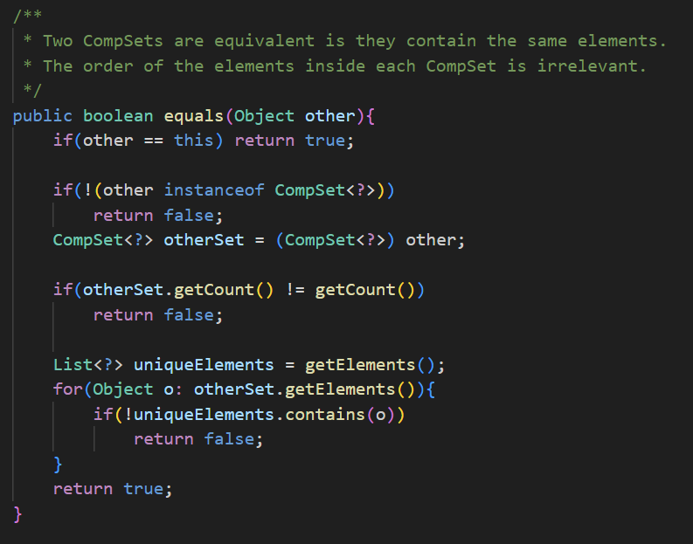

Slide 17
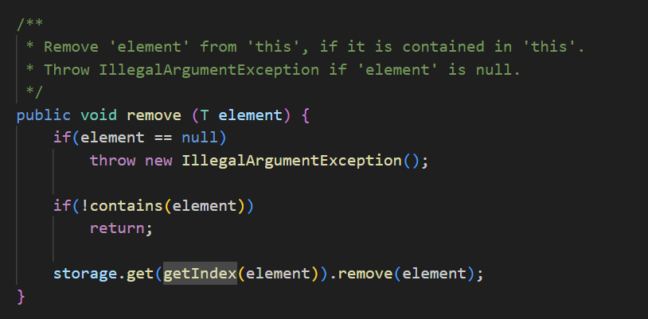

Slide 18
4. BankAccount Using Monitor Operations (10 points)
In this task, you will need to use synchronized methods/statements and operations like wait, notify, and notifyAll to coordinate the withdraw and deposite operations on a shared bank account.

Slide 19
